Slide 1
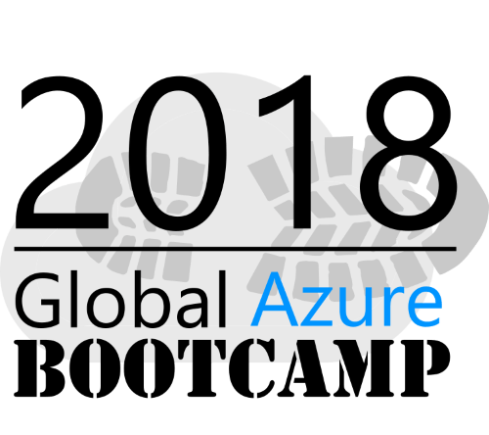

A Practical Guide to Azure Administration
Nick Westbrook | Azure MVP
@nickwestbrook

Slide 2
Objectives
Get to Know the Tools to Keep You
Aware
Secure
Saving Money
Notes:
…your boss will love you for it

Slide 3
Agenda
Administering an Azure Environment
Subscriptions
Directories
RBAC
Resource Groups
Tagging
Cost Management
Policy
Alerting
Monitoring
Advisor
Mobile App

Slide 4
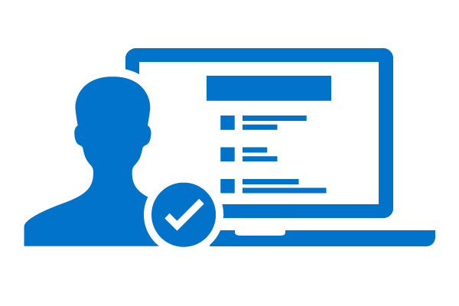
2 Key Considerations
$
Payment
Access
Notes:
Who’s going to pay for it?
Who has access to it?
Structures available in Azure allow us to address these independently

Slide 5

The Subscription
Admin Boundary
Billing Boundary
Container for Resources

Slide 6
Subscription as an Admin Boundary
Service Administrator
https://portal.azure.com
Only one per subscription
Manage access to subscription resources
Manage & add resources within the subscription

Slide 7
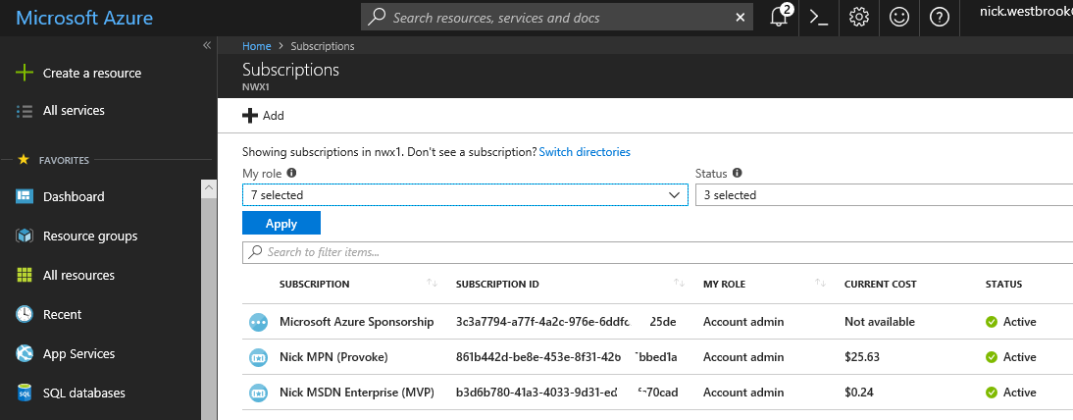
Subscription as a Billing Boundary

Slide 8
Access Management
Notes:
Who has access to it?
Structures available in Azure allow us to address these independently

Slide 9


The Directory
User Accounts
(+Groups, Resources, Apps, etc)
directoryname.onmicrosoft.com

Slide 10
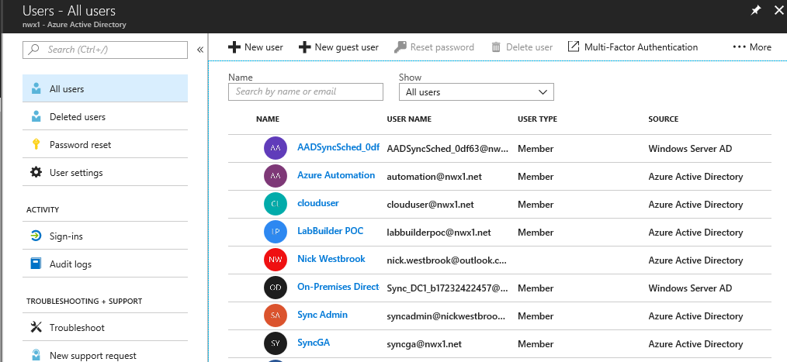
Directory Users Can Be Synced
“cloud-only” user
synced user

Slide 11



Access Management in Azure
Azure AD Directory or Tenant
(contoso.onmicrosoft.com)
User Accounts
Access
Trust
Access
Subscription
Resource Group
Resources

Slide 12
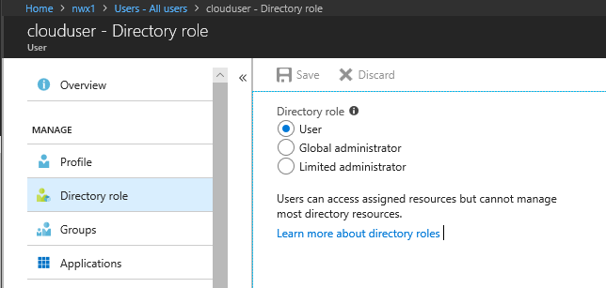
Directory Roles

Slide 13
Access Management in Azure
Azure AD Directory or Tenant
(contoso.onmicrosoft.com)
Global Admin
Trust
Subscription
Read-Only User or No Access
Resource Group
Resources

Slide 14
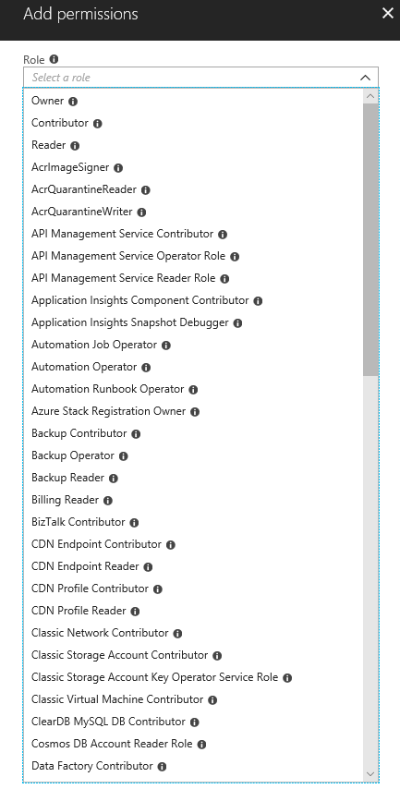
Subscription Access Roles
Owner (Full Control)
Contributor (Read/Write, no Setting Security)
Reader (Read Only)

Slide 15
Demo: Access Control

Slide 16
Resource Groups
Resource Group
Logical containers for grouping components into services
Service lifecycle boundary
Management boundary
Roll-up unit for billing, metering, accounting etc

Slide 17
Number of Resource Groups?
Single Resource Group
Separate Resource Groups
Contributor on RG

Slide 18

Tagging
Examples
Owner: Rajesh
Cost Center: Finance
Environment: Production
Useful for grouping and billing

Slide 19
Demo: Resource Groups
Tagging

Slide 20
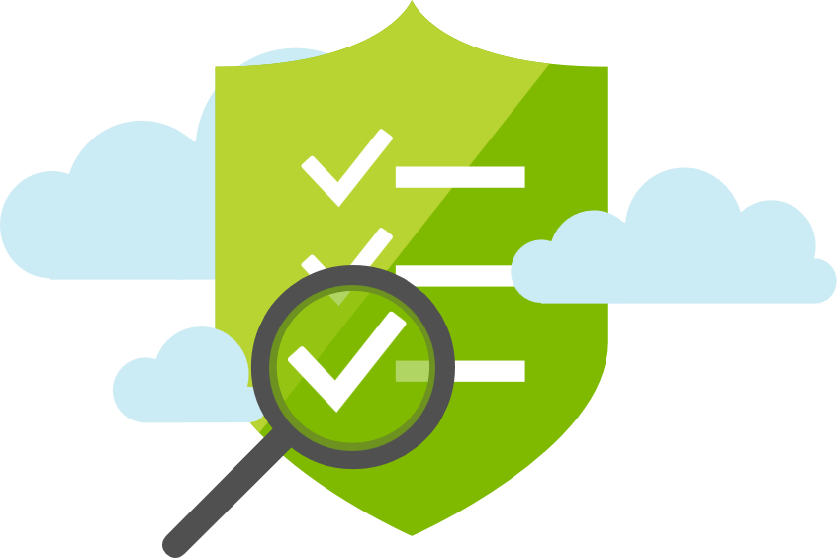
Policy
Examples
No expensive VMs allowed
Only deploy in Australia
Anti-malware MUST be installed on all VMs

Slide 21
Demo: Policy

Slide 22

Alerts
Examples: Activity Log
Tell me if someone tries to build an expensive VM
Tell me if someone deletes any databases
Examples: Metric
Tell me if CPU > 80%
Tell me if Disk Space Low

Slide 23
Demo: Alerts

Slide 24

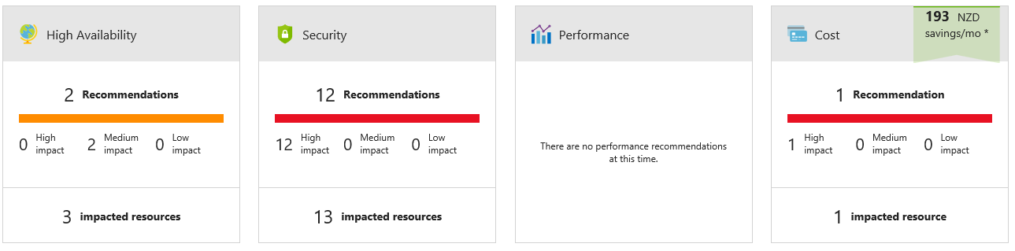
Azure Advisor

Slide 25


Azure Mobile App
Notes:
https://www.youtube.com/watch?v=MJhp3tnSKm8

Slide 26
Recap
Administering an Azure Environment
Subscriptions
Directories
RBAC
Resource Groups
Tagging
Cost Management
Policy
Alerting
Monitoring
Advisor
Mobile App

Slide 27
GO TRY IT!
Find the Lab PDF in the same location as this slide deck

